Slide 1
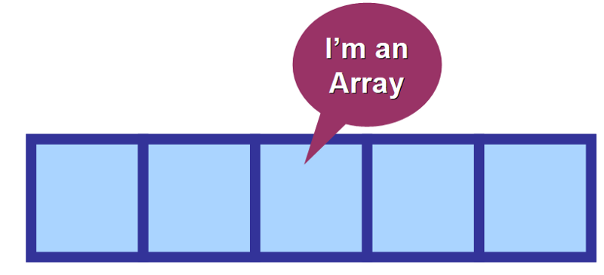

Arrays
Programming Club, AKGEC

Slide 2
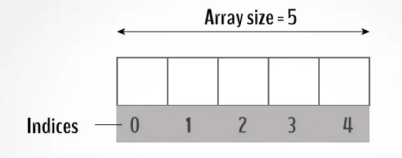
Quick brief on Arrays
An array is a collection of similar data elements stored at contiguous memory locations.
It is the simplest data structure where each data element can be accessed directly by only using its index number.
Example :

Slide 3
Why Arrays?
In programming, most of the cases need to store a large amount of data of a similar type.
We need to define numerous variables to store such a huge amount of data. While writing the programs, it would be very tough to memorize all variable names.

Slide 4
Declaration of an array
In C :
int a[3];
2312 | 1231 | 1233

Slide 5
1 | 2 | 3
int a[3] = { 1, 2, 3 };
int a[3] = { 1, 1, 1 };
1 | 1 | 1

Slide 6
0 | 0 | 0
int a[3] = { };
int a[3] = { 0 };
int a[3] = { 1 };
0 | 0 | 0
1 | 0 | 0

Slide 7
3 | 3 | 0
int a[3] = { [ 0…1 ]=3 };
int a[ ] = { [ 0…1 ]=3 };
3 | 3

Slide 8
As pointers to base address
int *a;
0 | 1 | 2 | 3 | 4

Slide 9

Limits on array size
Although platform dependent,
Generally, the maximum allowable array size is 65,536 bytes (64K).
(mainly in C,C++)
You can roughly store 10⁵ elements in an integer array.

Slide 10
Advantages of Arrays
Arrays represent multiple data elements of the same type using a single name.
Accessing or searching an element in an array is easy by using the index number.
An array can be traversed easily just by incrementing the index by 1.

Slide 11
Questions

Slide 12
Q1. Take Input of subject marks of 5 subjects from user and print the average marks.

Slide 13
Code
#include<bits/stdc++.h>
using namespace std;
int main(){
//Array of size 5 for 5 subjects
float marks[5];
//Take input marks
for(int i=0;i<5;i++)
cin>>marks[i];
//Take sum of the marks
float sum=0;
for(int i=0;i<5;i++)
sum=sum+marks[i];
//Result
cout<<”Average = “<<sum/5;
return 0;
}

Slide 14
Input
36 48 72 91 53
Solution
Output
Average =60

Slide 15
Q. Print the index of last occurrence of a given integer(say 5) in an array. Print -1 if did not occur.

Slide 16
Code
#include<bits/stdc++.h>
using namespace std;
int main(){
//Given Array
int array[8]={ 1, 5, 9, 7, 9, 5, 5, 7 };
//Declare variable to store index
int index = -1;
for(int i=0;i<8;i++){
if( array[i]==5){
index = i;
}
}
//Result
cout<<”Last Occurrence at = “<< index;
return 0;
}

Slide 17
Solution
Received Output
Last Occurrence at = 6

Slide 18
Bonus Question :
#include<bits/stdc++.h>
using namespace std;
int main(){
//Given Array
int array[8] = { 1, 5, 9, 7, 9, 5, 5, 7 };
cout<< 3[array];
return 0;
}
Q. Tell the output of the following code.

Slide 19
Solution
Received Output:
7
Why ?
a[3] -> ( a + 3*4)
3[a] -> (3*4 + a)
same interpretation !

Slide 20
Happy
Learning
;)

